Slide 1
Swampscott YRbs

Slide 2
What and who?
Survey looking at common risky behaviors
Nationally administered by the CDC
Swampscott added various questions related to mental health
940 students took the survey
493 at the middle school
447 at the high school
Notes:
Looking for trends, not individual answers, which helps us avoid making errors and being misled

Slide 3
How do we know the results are valid?
Safeguards within the instrument
Results examined for broader trends, not individual responses
Triangulation
Notes:
Triangulation—checking our other sources, such as the number of hospitalizations correlating with the number of students reporting needing hospitalization

Slide 4
Framing questions
What do we want to do with this information?
What are some things that are within your control to change?
Where should we start?

Slide 5

A word on reactions…
Notes:
May evoke many different feelings, ranging from happiness to anger, guilt, even shame.
These statistics are what they are. We all own them as a community. You should feel proud of what your do every day for kids in Swampscott and none of this takes away from that.

Slide 6
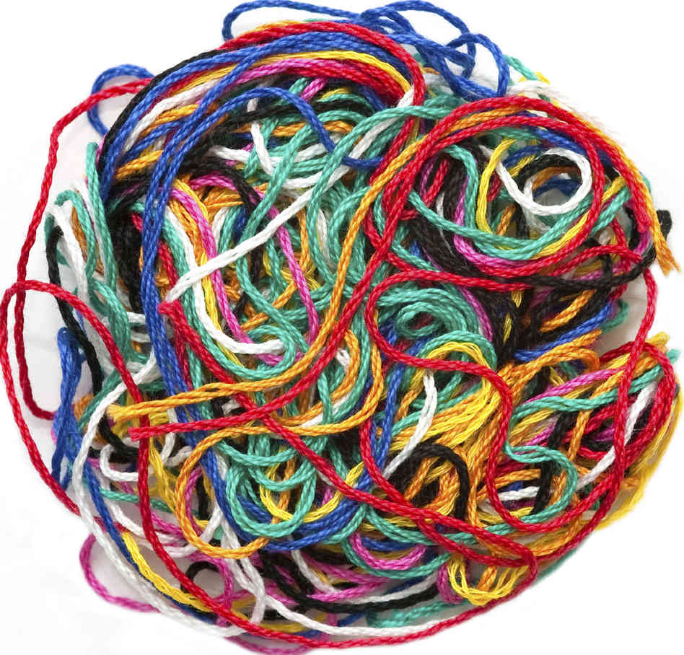
…And another word on causes
Notes:
Trying to say why things are the way they are will take time and detailed analysis. It’s easy to deflect any given statistic by linking it to another. I’m going to ask that everyone try to look at these with fresh, non-judgmental, and open eyes.
Also hard to determine what belongs in what area.
Many threads and causes—try to think in terms of this AND this, not just one.

Slide 7
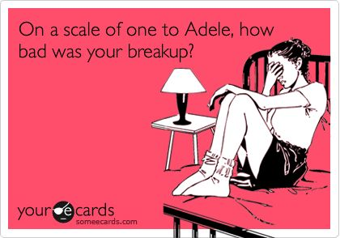
So…was it bad?

Slide 8
Areas of Focus
School Climate
  Does school feel like a safe and positive place?
Mental Health
  Anxiety, depression, and suicidal behaviors
Unhealthy/Risky Behaviors
  Sex, drugs, and rock and roll
Notes:
School Climate: being connected to a larger whole, feeling safe, engaged, and welcomed. Reflects both individual experiences and greater organization practices. No one slips through the cracks.

Slide 9
School climate

Slide 10
The good
A majority of students at the high school and middle school feel engaged and connected
  73% of students at the HS and 88% of students at the MS agreed or strongly agreed that their teachers cared about them
  78% of HS students and 86% of MS students had an adult at school they trust
  Over 90% of HS and MS students had at least one friend at school they trust
Students overwhelmingly want to do well
  More than 90% of HS and 95% of MS students want to do well in school

Slide 11
The not so good
There’s a sizable minority who are disconnected.
  27% of students at the MS said that school never or sometimes feels good to them; that number jumps to 52.4% (234) of students at the HS
  26% (115) of students at the HS disagree or strongly disagree that teachers care
  19% (86) of students do not have a trusted adult at the HS, while 10% (49) do not have a trusted adult at the MS
1% (5) of HS students said they carried a weapon to school in the past 30 days
Notes:
Well below state average on weapons—4-5, while there’s a non-zero chance, it’s not a reason to feel unsafe

Slide 12
Bullying
Middle School
High School
34% (166) of students reported being bullied on school property in the past year
26% (127) of students reported being electronically bullied in the past year
18% (81) of students reported being bullied on school property in the past year
17% (74) of students reported being electronically bullied in the past year
Notes:
Generally within state norms

Slide 13
Mental Health
Notes:
Going to talk about areas like anxiety and depression, but please note that this isn’t diagnosis—it’s a very rough estimate based on the population

Slide 14
I FEEL OVERWHELMED BY THE AMOUNT OF WORK I HAVE TO DO FOR SCHOOL
6th Grade
Notes:
Academic pressures—this isn’t to say that too much work is being given out or that things are too hard, this is the perception of the student body

Slide 15
I FEEL OVERWHELMED BY THE AMOUNT OF WORK I HAVE TO DO FOR SCHOOL
7th Grade

Slide 16
I FEEL OVERWHELMED BY THE AMOUNT OF WORK I HAVE TO DO FOR SCHOOL
8th Grade

Slide 17
I FEEL OVERWHELMED BY THE AMOUNT OF WORK I HAVE TO DO FOR SCHOOL
9th Grade

Slide 18
I FEEL OVERWHELMED BY THE AMOUNT OF WORK I HAVE TO DO FOR SCHOOL
10th Grade

Slide 19
I FEEL OVERWHELMED BY THE AMOUNT OF WORK I HAVE TO DO FOR SCHOOL
11th Grade

Slide 20
I FEEL OVERWHELMED BY THE AMOUNT OF WORK I HAVE TO DO FOR SCHOOL
6th Grade

Slide 21
I FEEL OVERWHELMED BY THE AMOUNT OF WORK I HAVE TO DO FOR SCHOOL
11th Grade

Slide 22
I always feel overwhelmed by the amount of work I have to do for school

Slide 23
I FEEL PRESSURED TO BE ACADEMICALLY PERFECT...

Slide 24
I FEEL PRESSURED TO BE ACADEMICALLY PERFECT...

Slide 25
I FEEL PRESSURED TO BE ACADEMICALLY PERFECT...

Slide 26
I FEEL PRESSURED TO BE ACADEMICALLY PERFECT...

Slide 27
I FEEL PRESSURED TO BE ACADEMICALLY PERFECT...

Slide 28
I FEEL PRESSURED TO BE ACADEMICALLY PERFECT...

Slide 29
Stimulant Drug use for academics
MIDDLE SCHOOL

Slide 30
Stimulant drug use for academics
HIGH SCHOOL
Notes:
42 students total within the past year

Slide 31
Anxiety
Anxiety appears to be prevalent across our student body
  25% of students at the HS and 18% of students at the MS report that they often or always have a lot of worries that are difficult to control
  19% (181) of all students reported that they often or always get so nervous during tests that they have a hard time concentrating
  46% of students reported symptoms consistent with a panic attack in the past year; 22% (204) of students said they experience 3 or more in the past year

Slide 32
Depression
Generally lower prevalence than anxiety, more stable over development
  Around 16% of students report anhedonia (loss of pleasure)
  15% of students feel sad often or always
  8% often or always feel hopeless about the future

Slide 33
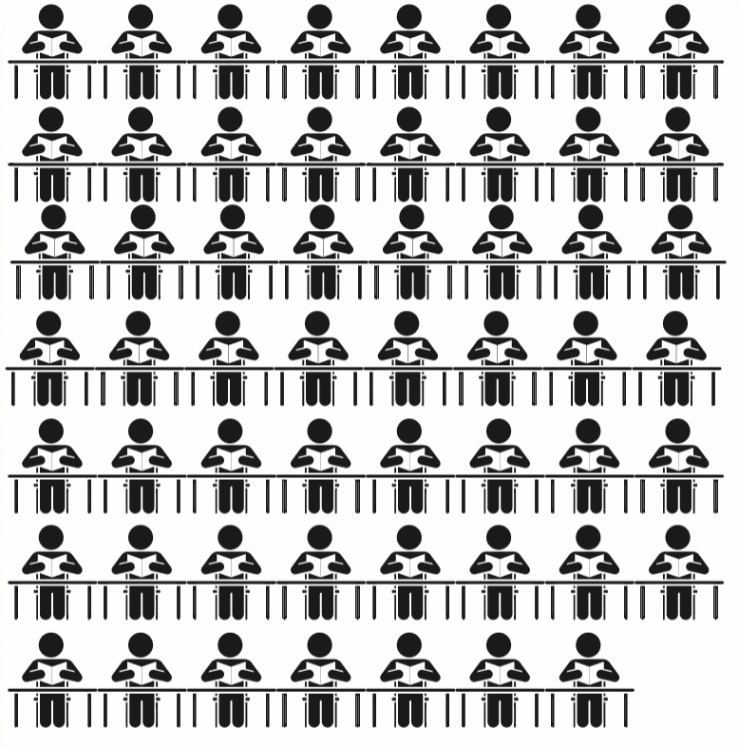
Suicide
High School
55 (12.3%) had suicidal ideation
Notes:
Slightly below state norms (13-15)

Slide 34
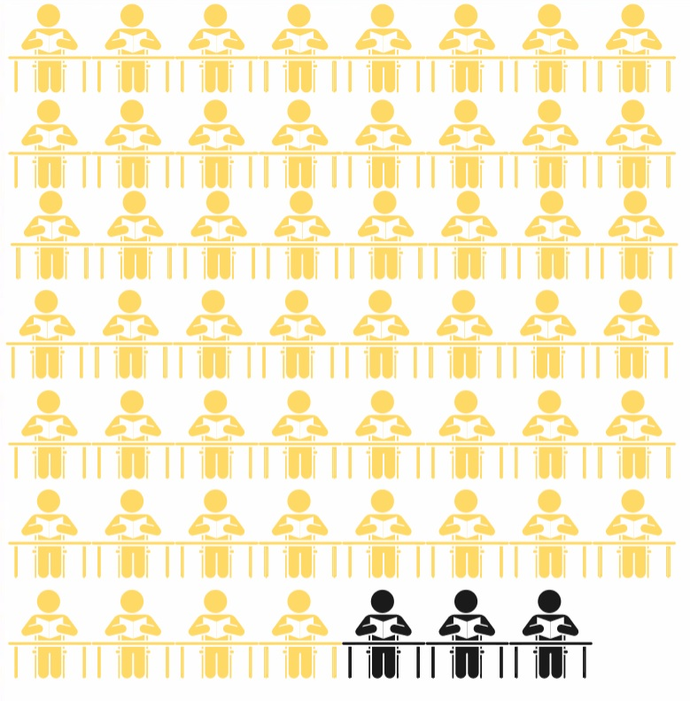
Suicide
High School
55 (12.3%) had suicidal ideation
52 (11.6%) made a plan about how they would attempt suicide
Notes:
Within average

Slide 35
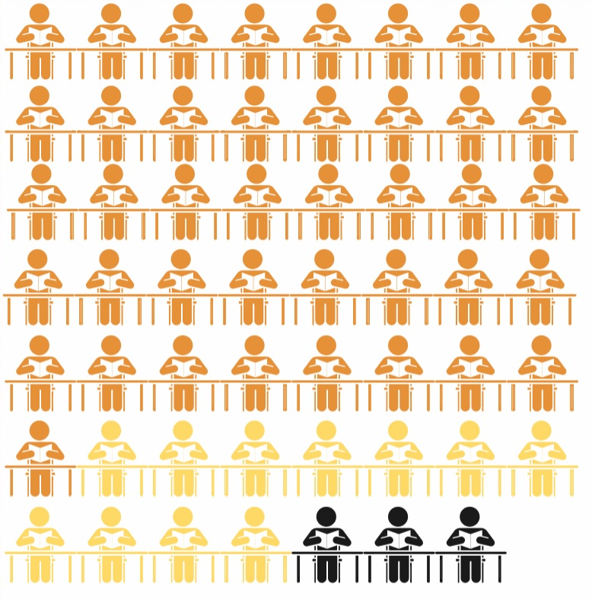
Suicide
High School
55 (12.3%) had suicidal ideation
52 (11.6%) made a plan about how they would attempt suicide
41 (9.2%) made one or more attempt

Slide 36
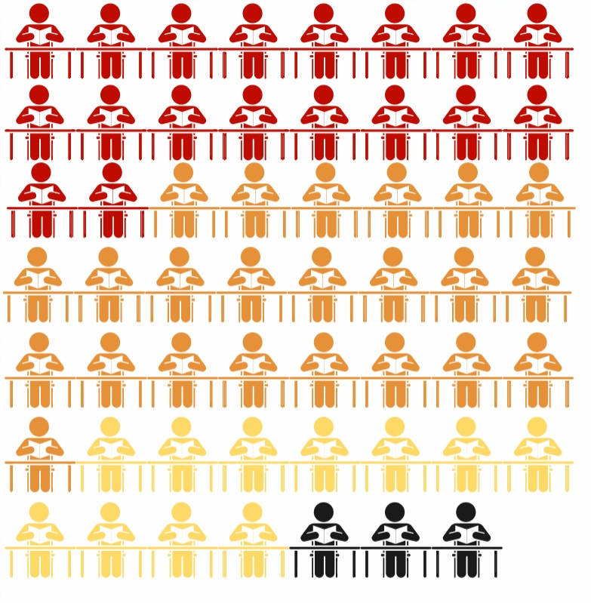
Suicide
High School
55 (12.3%) had suicidal ideation
52 (11.6%) made a plan about how they would attempt suicide
41 (9.2%) made one or more attempt
18 (4%) attempts were serious enough to need medical attention
Notes:
At the MS it was much the same—78 students with ideation, 55 who planned, 18 attempts
Triangulation of data—just about matches with the number of hospitalizations we’ve seen over the previous year
These are generally within state norms

Slide 37
Unhealthy/RISKY Behaviors

Slide 38
Drug use
Substances of choice are alcohol and marijuana
84% of MS students have not drunk alcohol (other than a few sips); 39% of HS students have not drunk alcohol
Over 91% of MS student have not used marijuana; 59% of HS students have not used marijuana
37% of students at the HS and 13% of MS students have used an electronic vapor product
Around 2% of HS students have experimented with harder drugs (cocaine, aerosols, methamphetamine, ecstasy, opiates); however there is reason to believe this is inflated
During the previous year, 18% of HS students reported being offered, sold, or given an illegal drug on school property

Slide 39
Alcohol
42% of HS students had at least one drink in the previous 30 days
18% of students at the HS had ridden in a car driven by someone who had been drinking
43% of HS students had driven a car when they had been drinking
27% of HS got alcohol from someone else buying it or being given it by someone else
Notes:
Students riding with someone who had been drinking, within at state average (17-18.2)
Students who had driven while drinking is above state average

Slide 40
In the past 30 days, what is the largest number of alcoholic drinks you had in a row, that is, within a couple of hours?
Notes:
4 drinks is binging for adult females
5 drinks is binging for adult males
17% (76) students binge drinking by any definition

Slide 41
Age of first drink

Slide 42
During the past 30 days, how many times did you use marijuana?

Slide 43
During the past 30 days, how many times did you use marijuana?

Slide 44
Age when first using of Marijuana

Slide 45
Sex
42% (188) of HS students and 23% (114) of MS students have sent or received sexual photos
Around 5% (21) of HS students reported being a victim of sexual assault
Around 5% (24) of HS students reported physical abuse from a partner at least once in the past year

Slide 46
Students getting at least 8 hours of sleep on an average school night
Grade
Notes:
Goes from 74% in 6th grade to 16% in 11th

Slide 47
Screen time
Around 35% of students watch two or more hours of TV a night
Over 50% of students play video games or use a computer for something that is not school work for two or more hours each night

Slide 48
So, now what?
Notes:
An opportunity to intervene now the we know the information.

